Slide 1

Whatever The Gig, We Make It Big!
Tony Pau

Slide 2
Planning
Flowchart and Wireframes

Slide 3
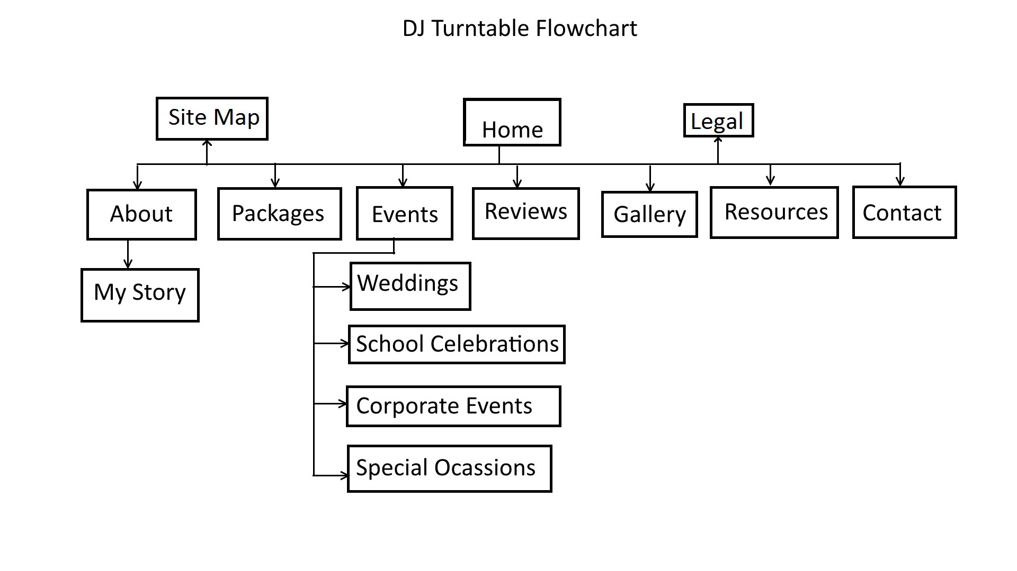

Slide 4
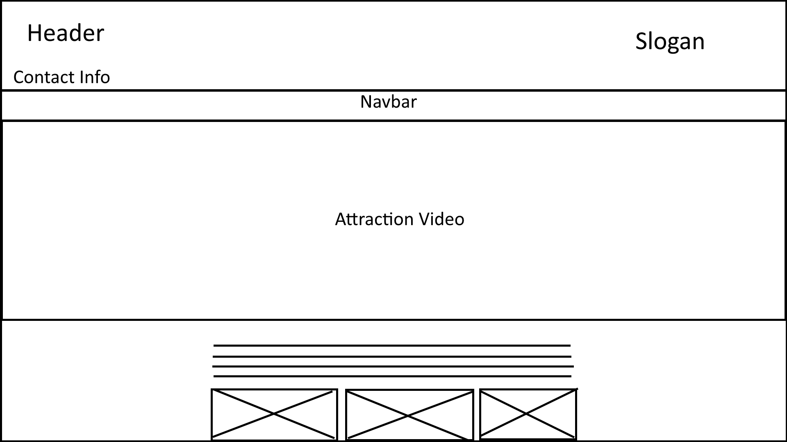

Slide 5
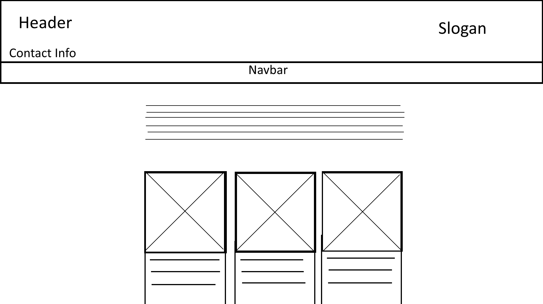

Slide 6
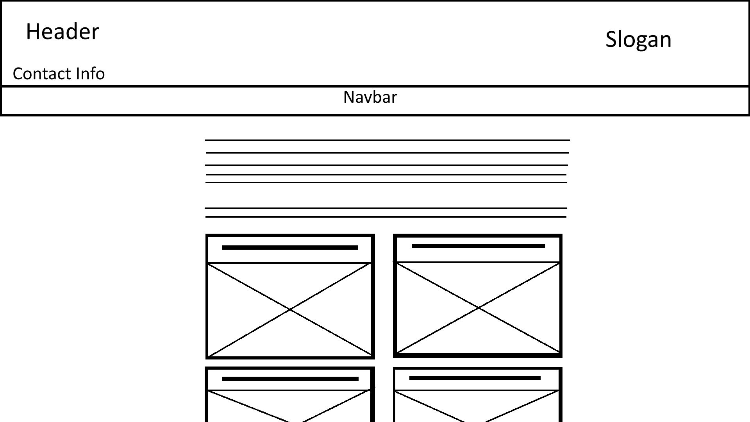

Slide 7
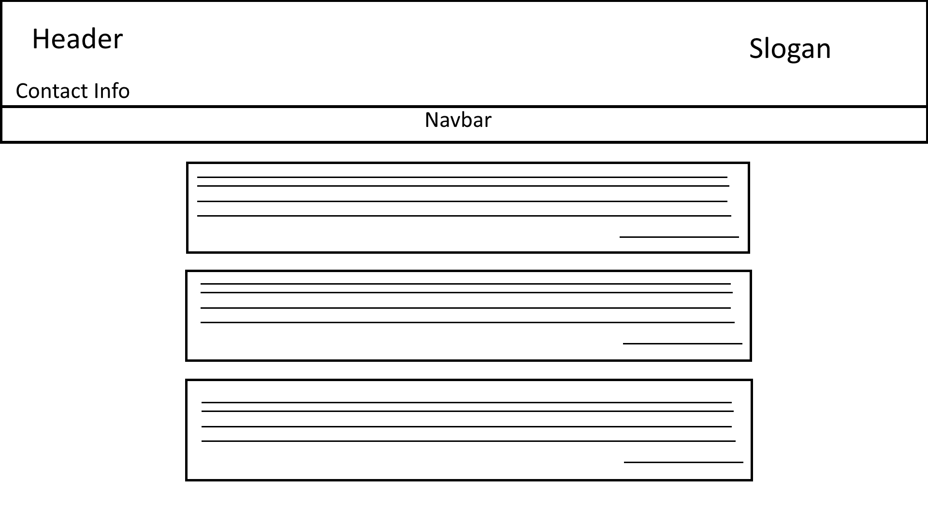

Slide 8
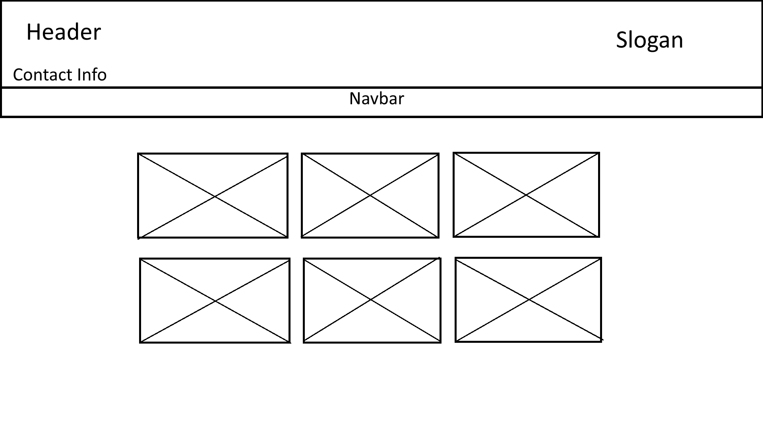

Slide 9
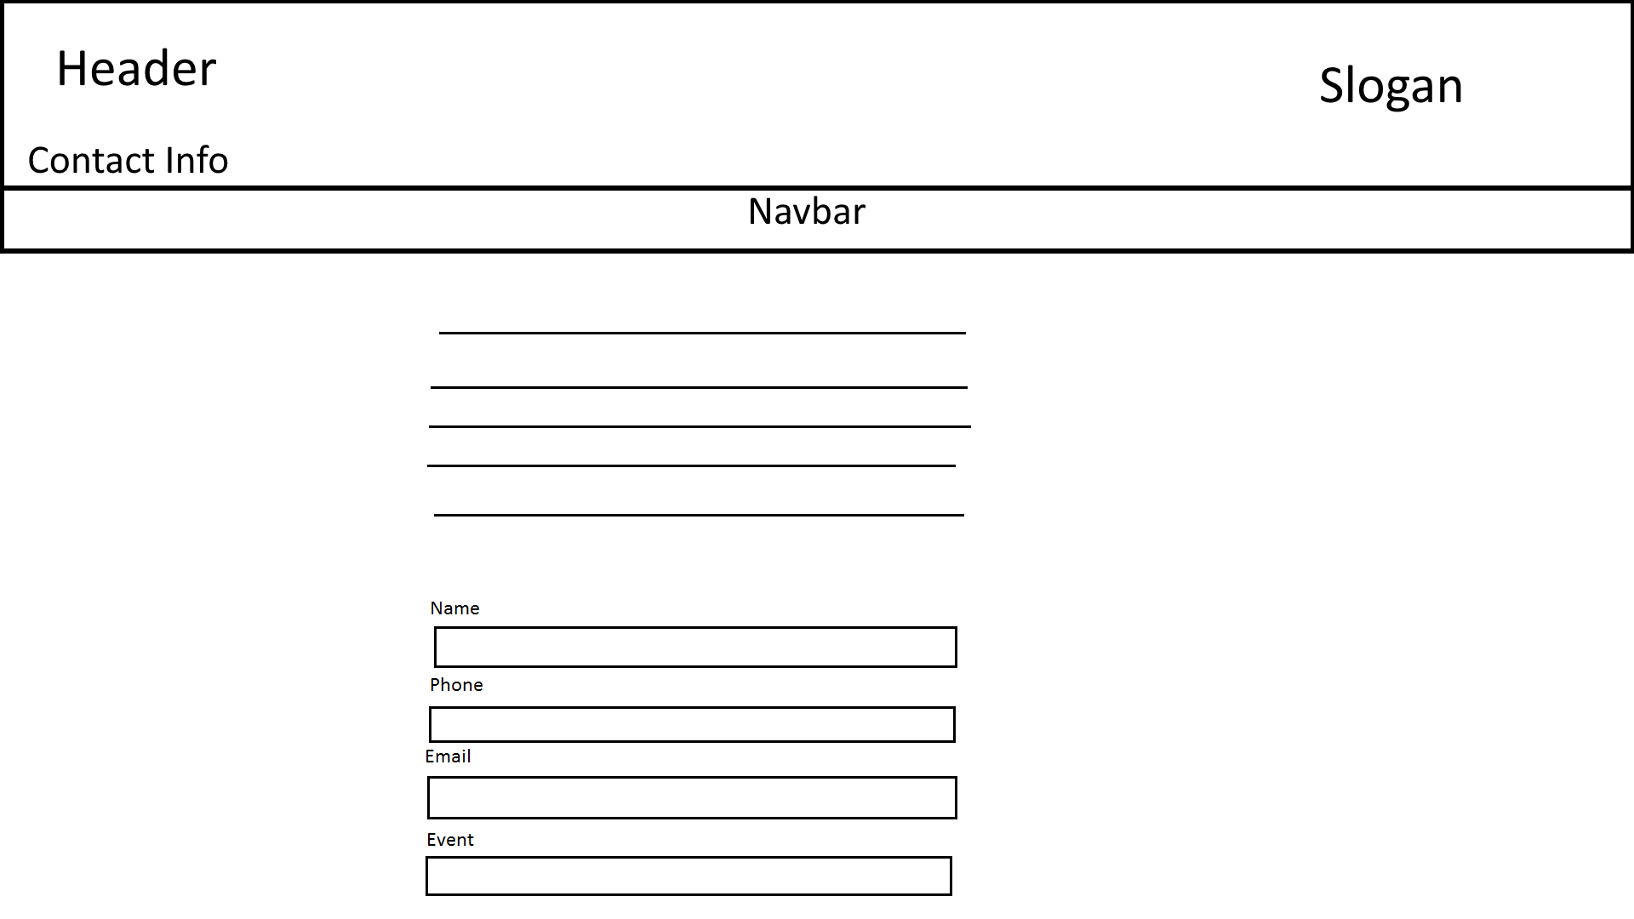

Slide 10
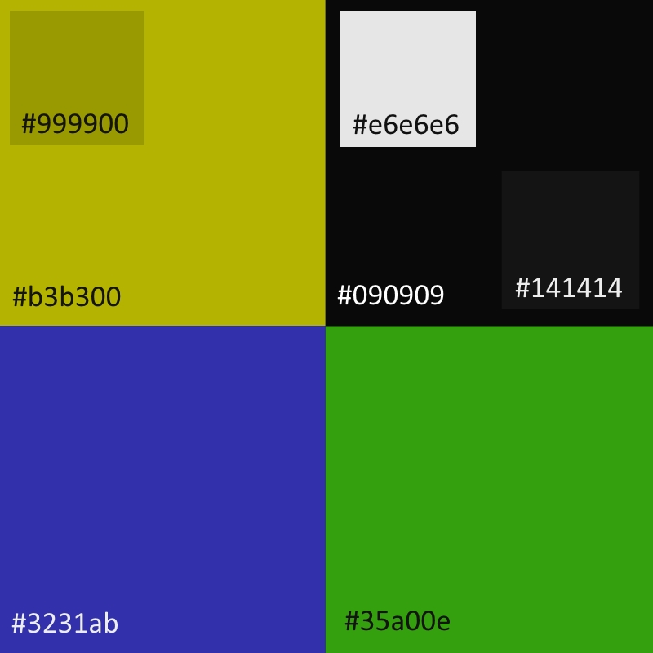
Color Scheme
Started with what the book told me, but I didn’t like the colors
I made adjustments throughout the project
Ended up with the colors on the right

Slide 12
Fonts
Russo One
Impact
Roboto
Arial
Helvetica

Slide 13

The Website

